Slide 1
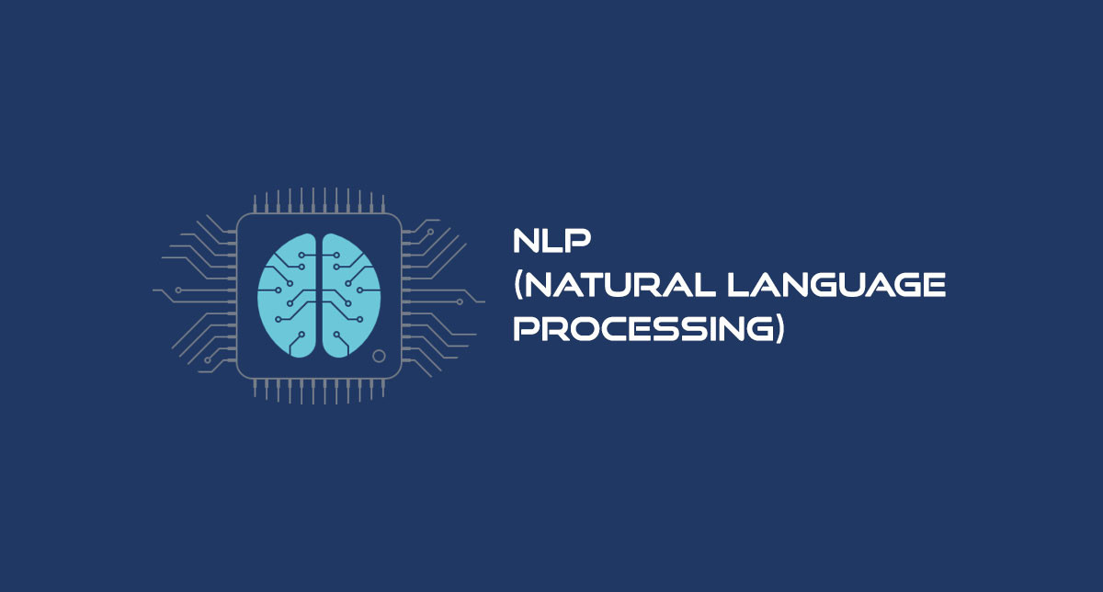

Slide 2
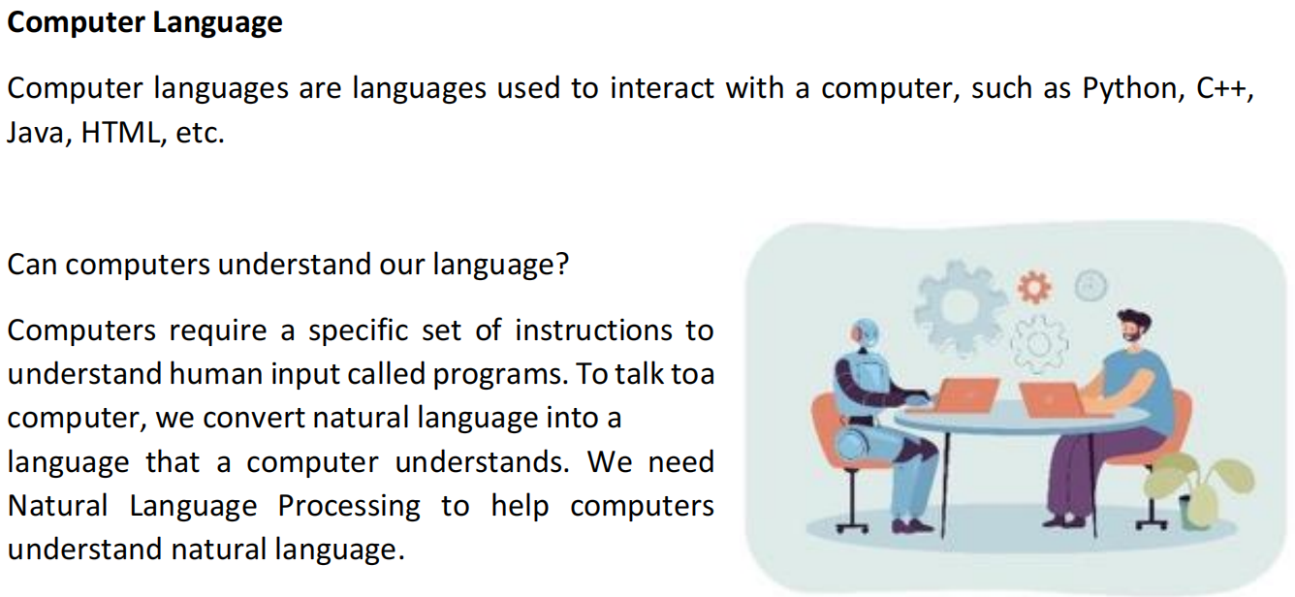

Slide 3
Why NLP is Important?
The whole purpose of NLP is to make communication between computer systems and humans possible. This includes creating different tools and techniques that facilitate better communication of intent and context.

Slide 4
Applicatios of NLP
NLP
Voice Assistants
Auto Generated Captions
Language Translations
Sentiment Analysis
Text Classification
Keyword Extraction

Slide 5

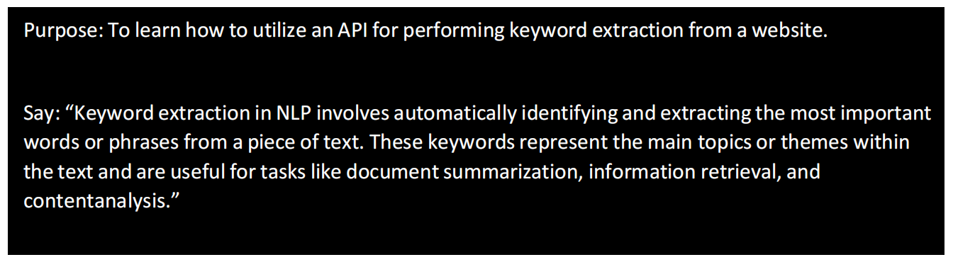
Keyword Extraction
https://cloud.google.com/natural-language

Slide 6

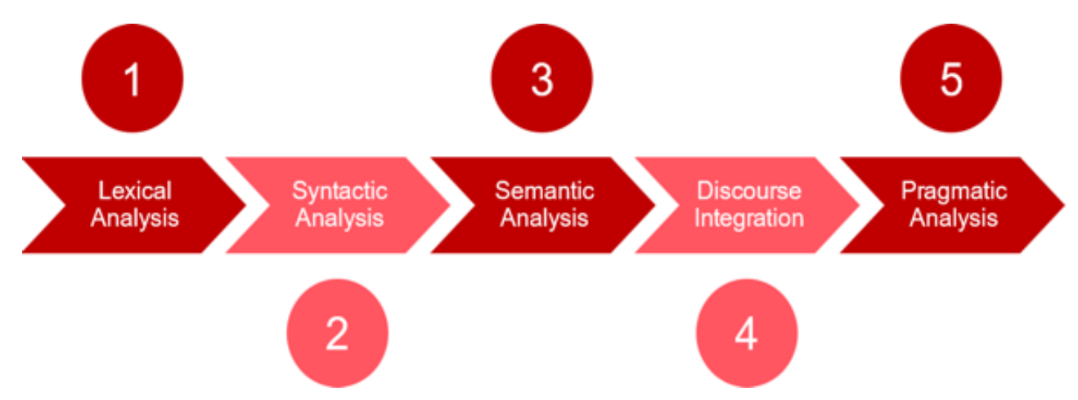
Stages of NLP
The different stages of Natural Language Processing (NLP)serve various purposes in the overall task of understanding and processing human language. The stages of Natural Language Processing (NLP) typically involve the following:

Slide 7
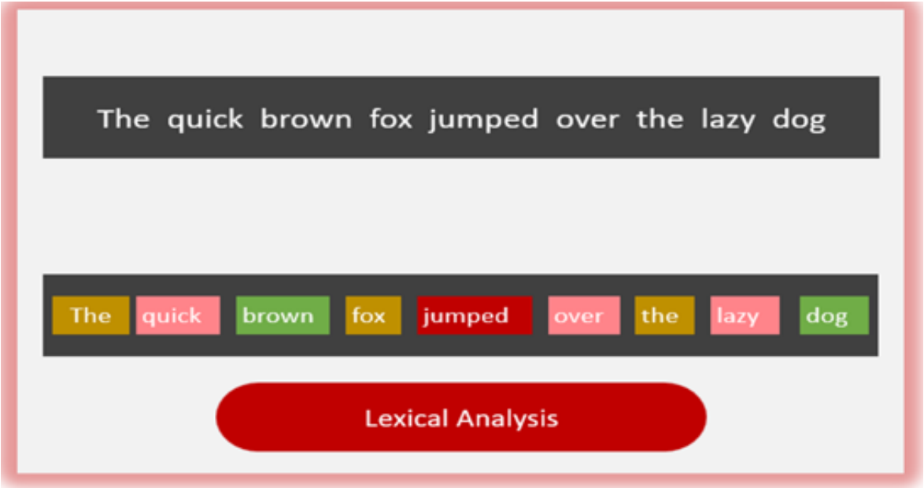
Lexical Analysis
NLP starts with identifying the structure of input words. It is the process of dividing a large chunk of words into structural paragraphs, sentences, and words. Lexicon stands for a collection of the various words and phrases used in a language.
Lengthy text is broken down into chunks.

Slide 8
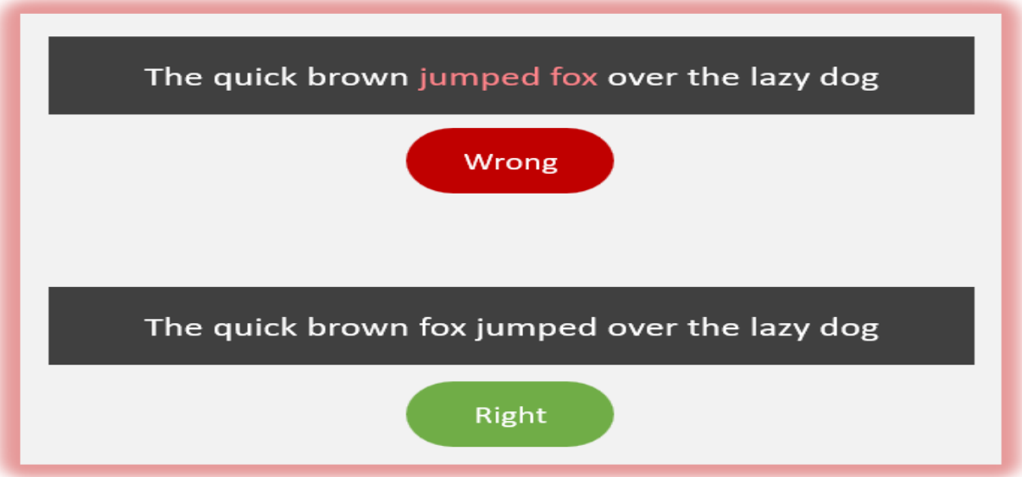
Syntactic Analysis / Parsing
It is the process of checking the grammar of sentences and phrases. It forms a relationship among words and eliminates logically incorrect sentences.
The Grammar is Correct!

Slide 9
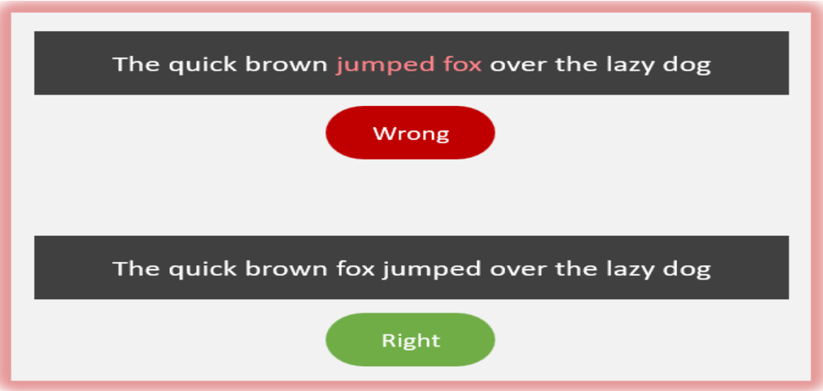
Sementic Analysis
In this stage, the input text is now checked for meaning, and every word and phrase is checked for meaningfulness.
For example:
It will reject a sentence that contains ‘hot ice cream’in it. The fox jumped into the dog.
Sentences make actual sense!

Slide 10
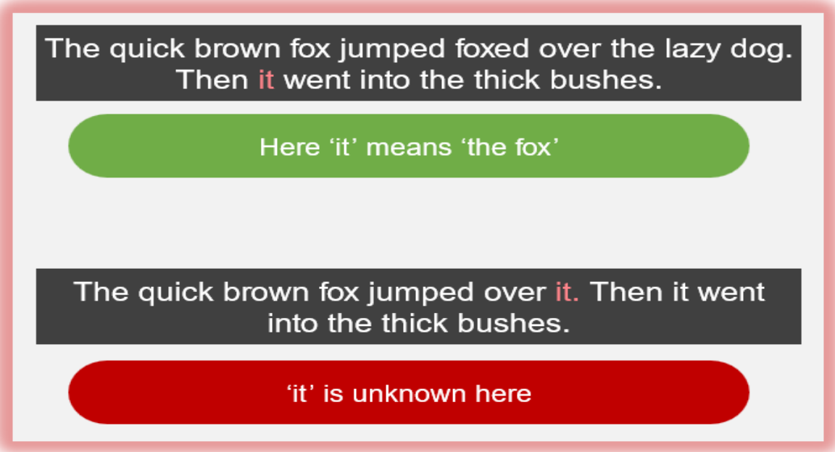
Discourse integration
It is the process of forming the story of the sentence. Every sentence should have a relationship with its preceding and succeeding sentences
The flow of words makes sense!

Slide 11
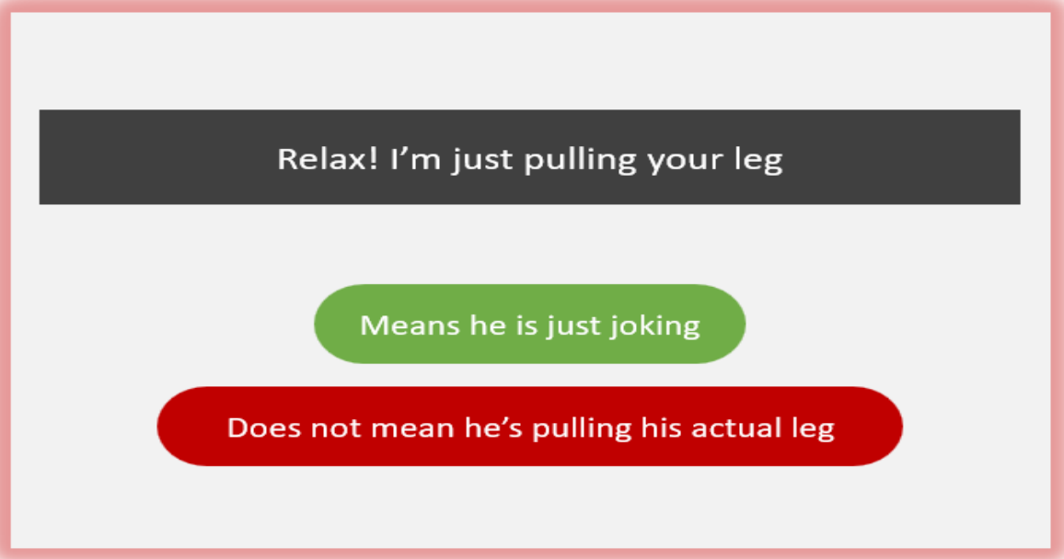
Pragmatic Analysis
In this stage, sentences are checked for their relevance in the real world. Pragmatic means practical or logical, i.e., this step requires knowledge of the intent in a sentence. It also means to discard the actual word meaning taken after semantic analysis and take the intended meaning.
The intended meaning has been achieved!

Slide 12
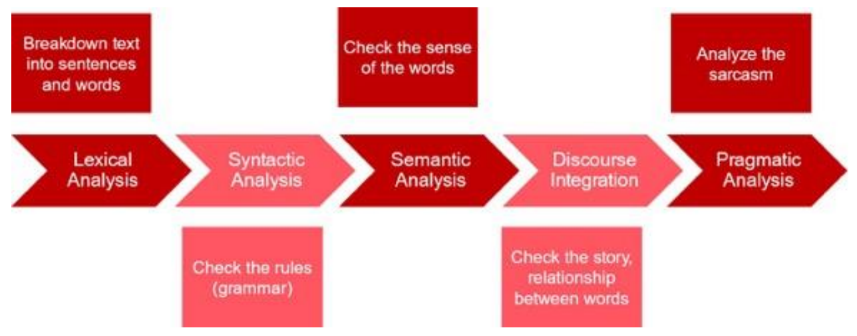
In summary,

Slide 13
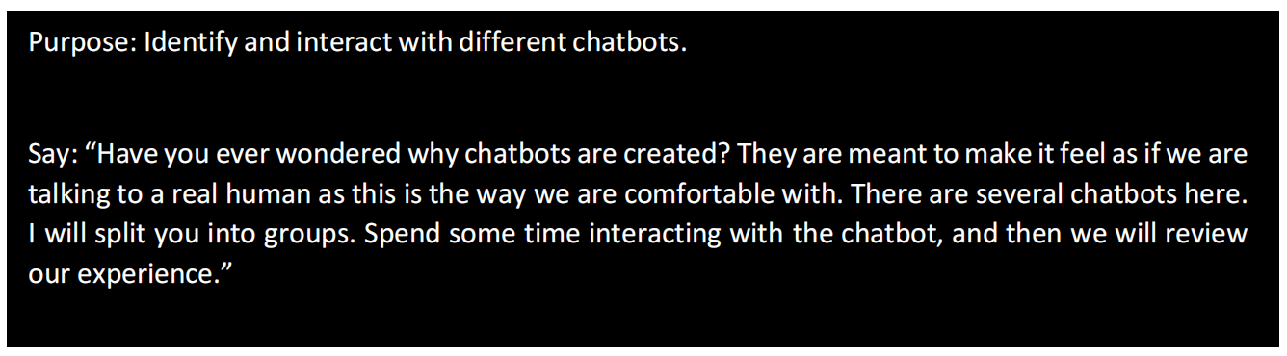
Chatbots
One of the most common applications of Natural Language Processing is a chatbot. A chatbot is a computer program that's designed to simulate human conversation through voice commands or text chats or both. It can learn over time how to best interact with humans. It can answer questions and troubleshoot customer problems, evaluate and qualify prospects, generate sales leads and increase sales on an ecommerce site. There are a lot of chatbots available.

Slide 14
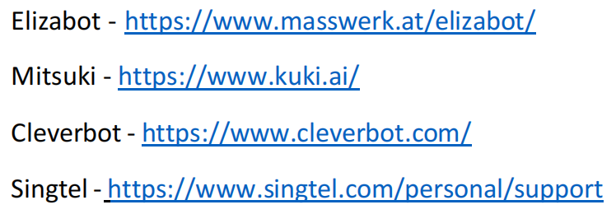
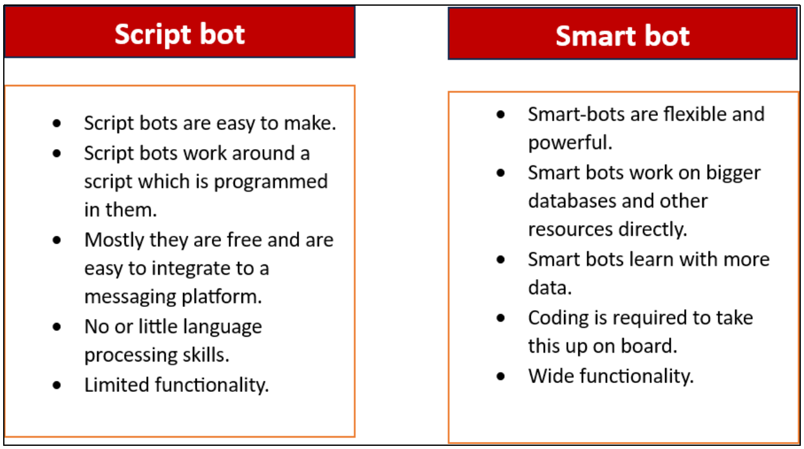
Let us try some of the chatbots and see how they work.

Slide 15
Text Processing
We all know that the language of computers is Numerical, the very first step that comes to our mind isto convert our language to numbers. This conversion takes a few steps to happen. The first step to it is Text Normalisation.
In Text Normalisation, we undergo several steps to normalise the text to a lower level. Before we begin, we need to understand that in this section, we will be working on a collection of written text. That is, we will be working on text from multiple documents andthe term used for the whole textual data from all the documents altogether is known as corpus.

Slide 16
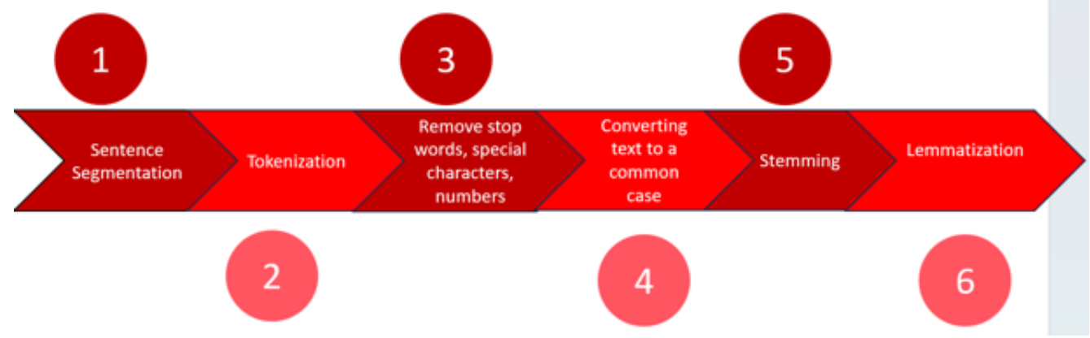
STEPS OF THE NORMALISATION

Slide 17
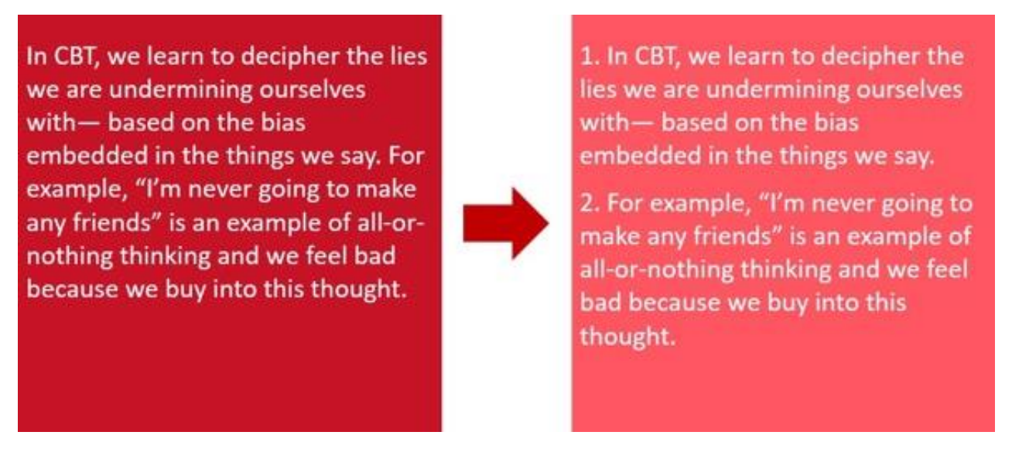
Sentence Segmentation
Under sentence segmentation, the whole corpus is divided into sentences. Each sentence is taken as a different data so now the whole corpus gets reduced to sentences.

Slide 18
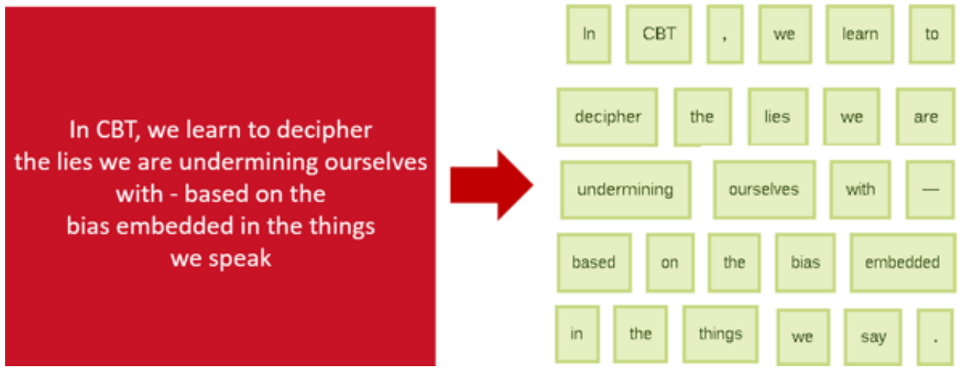
Tokenization
After segmenting the sentences, each sentence is then further divided into tokens. Tokens is a term used for any word or number or special character occurring in a sentence.

Slide 19
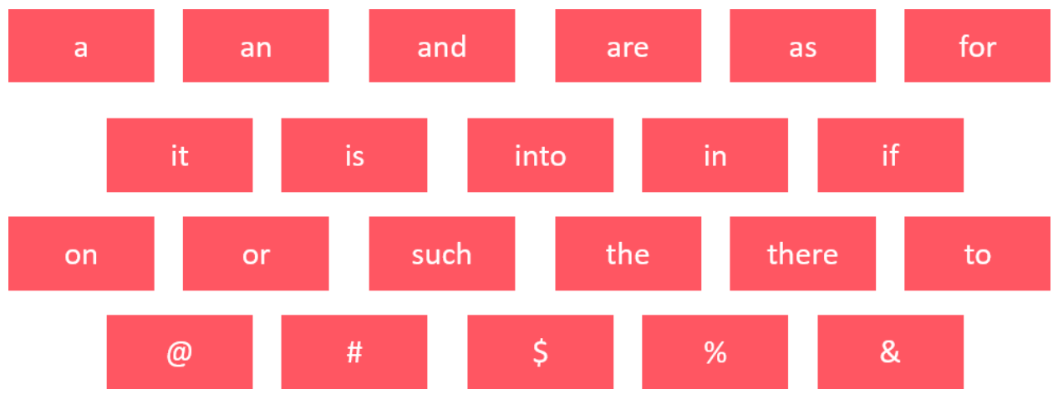
Removing Stop words, Special Characters and Numbers
In this step, the tokens which are not necessary are removed from the token list. What are the possible words which we might not require?
These words occur the most in any given corpus but talk very little or nothing about the context or the meaning of it. Hence, to make it easier for the computer to focus on meaningful terms, these words are removed.

Slide 20
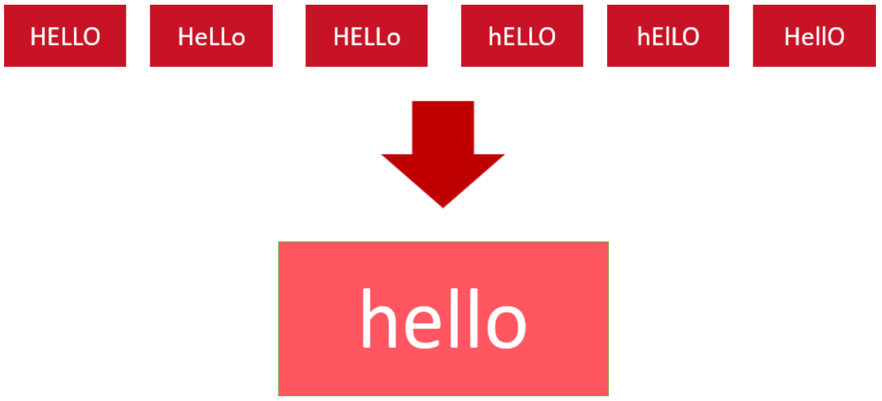
Converting text to a Common Case
After the stop wordsremoval, we convert the whole text into a similar case, preferably lowercase. This ensures that the case sensitivity of the machine does not consider the same words as different just because of different cases.
Here in this example, all the 6 forms of hello would be converted to lowercase and hence would be treated as the same word by the machine.

Slide 21

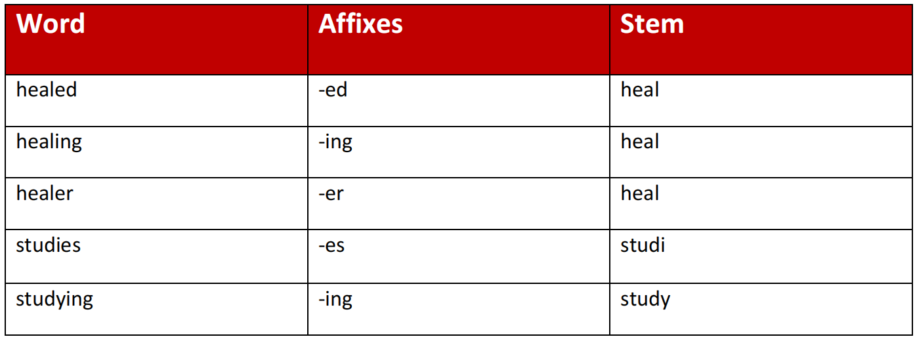
Stemming
In this step, the remaining words are reduced to their root words. In other words,stemmingis the process in which the affixes of words are removed and the words are converted to their base form.
Note that in stemming, the stemmed words (words that we get after removing the affixes) might not be meaningful. Here in this example as you can see: healed, healing and healer all were reduced to heal but studies was reduced to studi after the affix removal which is not a meaningful word. Stemming does not take into account whether the stemmed word is meaningful or not. It just removes the affixes hence it is faster.

Slide 22
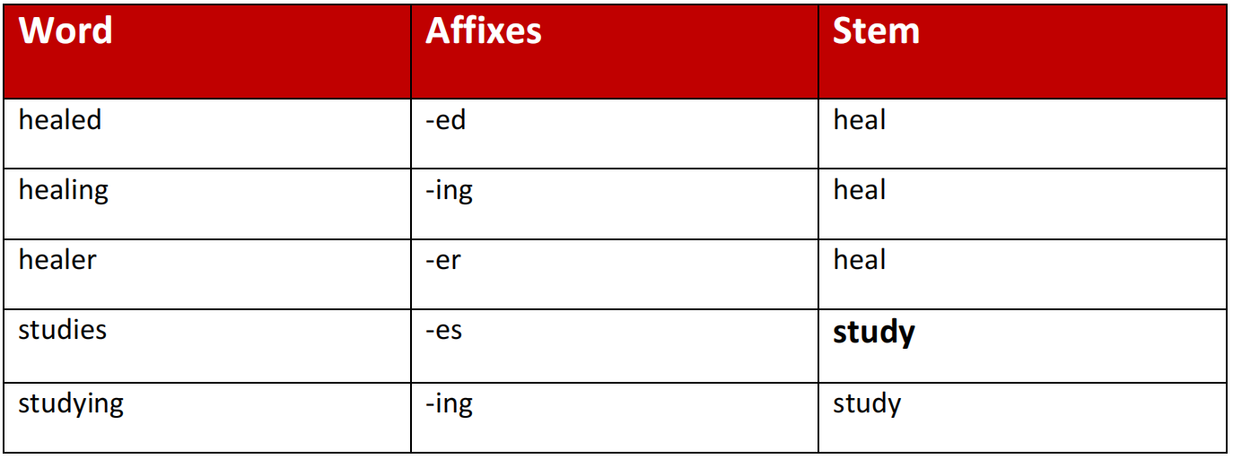
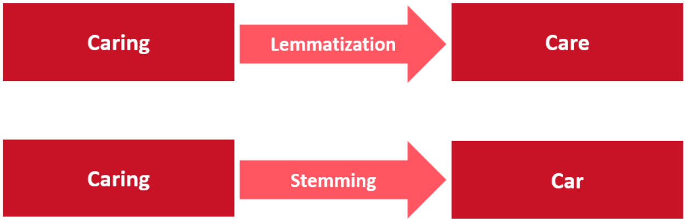
Lemmatization
Stemming and lemmatization both are alternative processes to each other as the role of both the processes is same – removal of affixes. But the difference between both of them isthat in lemmatization, the word we get after affix removal (also known as lemma) is a meaningful one.Lemmatization makes sure that a lemma is a word with meaning and hence it takes a longer time to execute than stemming.
The difference between stemming and lemmatization can be summarized by this example:

Slide 23
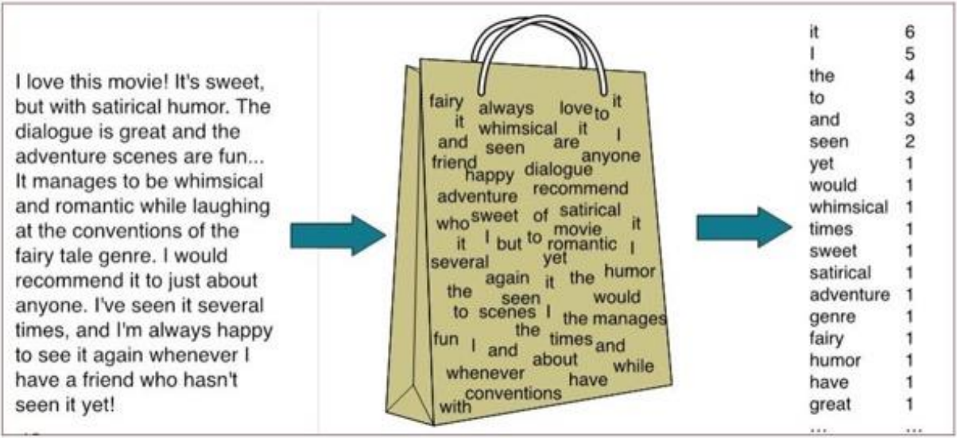
Bag of Words
Algorithm
Bag of Words is a Natural Language Processing model which helps in extracting features out of the text which can be helpful in machine learning algorithms. In the bag of words, we get the occurrences of each word and construct the vocabulary for the corpus.
Thus, we can say that the bag of words gives us two things:
1. A vocabulary of words for the corpus
2. The frequency of these words (number of times it has occurred in the whole corpus).
Here calling this algorithm a “bag” of words symbolizes that the sequence of sentences or tokens does not matter. In this case, all we need are the unique words and their frequency.

Slide 24
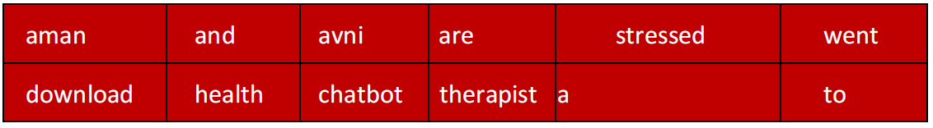
Implementing BOW (step by step)
Here is the step-by-step approach to implementing the bag of words algorithm:
Step 1: Collecting data and pre-processing it.
Document 1: Aman and Avni are stressed
Document 2: Aman went to a therapist
Document 3: Avni went to download a health chatbo
Step 2: Create a Dictionary
Go through all the steps and create a dictionary i.e., list down all the words which occur in all three documents:
Dictionary:
Note that even though some words are repeated in different documents, they are all written just once as while creating the dictionary, we create the list of unique words.

Slide 25
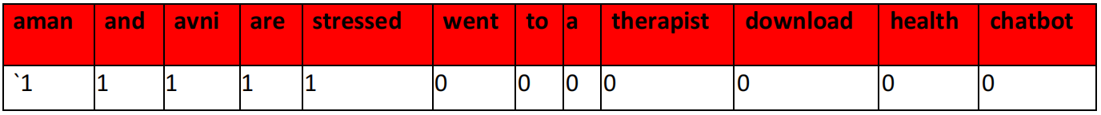
Step 3: Create a document vector
In this step, the vocabulary is written in the top row. Now, for each word in the document, fit matches the vocabulary, put a 1 under it. If the same word appears again, increment the previous value by 1. And if the word does not occur in that document, put a 0 under it.
Since, in the first document, we have words: aman, and, avni, are, stressed. So, all thesewords get a value of 1 and the rest of the words get a 0 value.

Slide 26
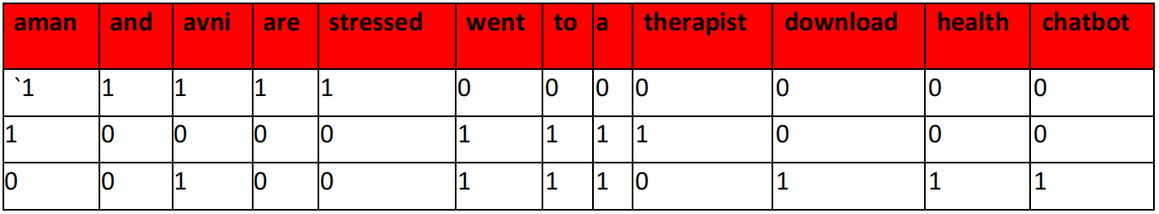
Step 4: Create document vectors for all the documents.
The same exercise hasto be done for all the documents. Hence, the table becomes:
In this table, the header row contains the vocabulary of the corpus and three rows correspond to three different documents. Take a look at this table and analyse the positioning of 0s and 1s in it. Finally, this gives us the document vector table for our corpus.
However, the tokens have still not been converted to numbers. This leads us to the final step of our algorithm: TF-IDF.

Slide 27
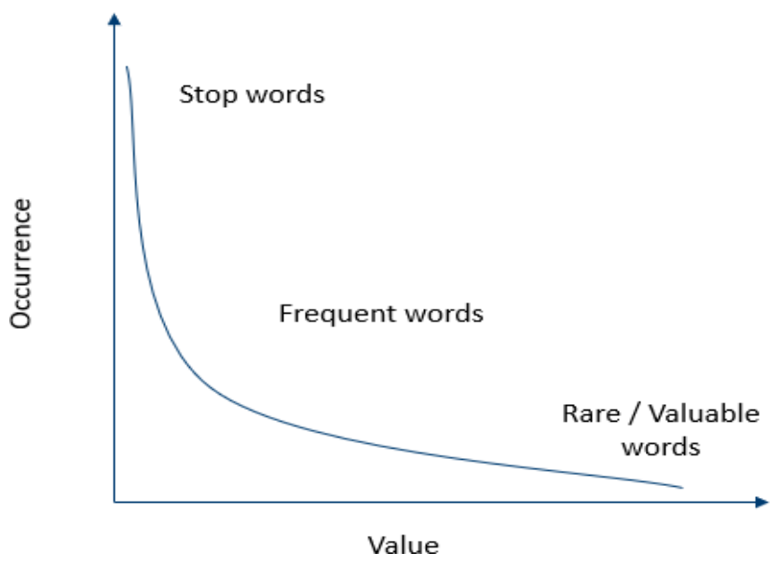
Term Frequency - Inverse Document Frequncy (TF-IDF)
And, this, is, the, etc. are the words which occur the most in almost all the documents. But these words do not talk about the corpus at all. Though they are important for humans as they make the statements understandable to us, for the machine they are a complete waste as they do not provide us with any information regarding the corpus. Hence, these are termed as stop words and are mostly removed at the pre-processing stage only

Slide 28
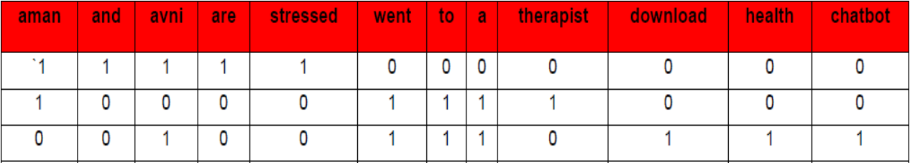
Term Frequency - TF
Term frequency is the frequency of a word in one document. Term frequency can easily be found in the document vector table as in that table we mention the frequency of each word of the vocabulary in each document.
Here, you can see that the frequency of each word for each document has been recorded in the table. These numbers are nothing but the Term Frequencies!

Slide 29
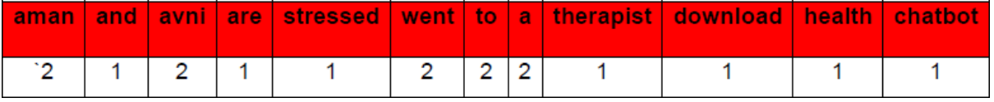
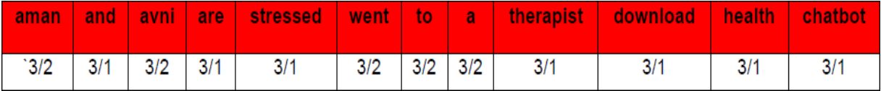
Inverse Document Frequency - IDF
Document Frequency is the number of documents in which the word occurs irrespective of how many times it has occurred in those documents.
Here, you can see that the documentfrequency of ‘aman’, ‘avni’, ‘went’, ‘to’ and ‘a’ is 2 as they have occurred in 2 documents. The rest of them occurred in just one document hence the document frequency for them is 1.
Talking about inverse document frequency, we need to put the document frequency in the denominator while the total number of documents is the numerator. Here, the total number of documents is 3, hence inverse document frequency becomes:

Slide 30
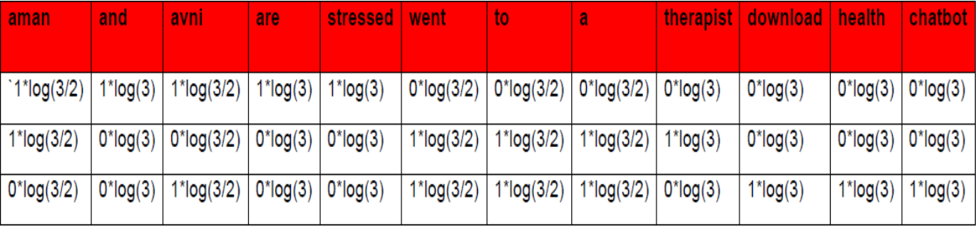
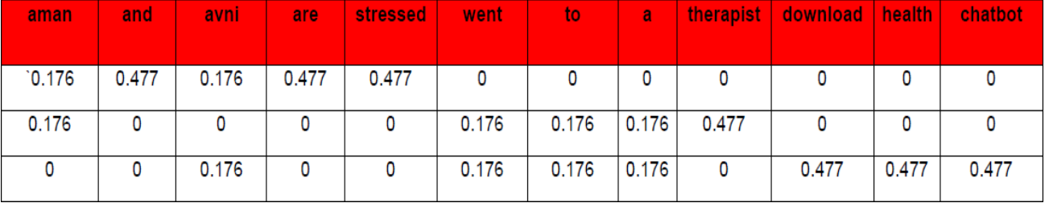
Formula
TFIDF(W) = TF(W) * log( IDF(W))
Note that the TF values are for each document while the IDF values are for the whole corpus. Hence, we need to multiply the IDF values to each row of the document vector table.

Slide 31
Calculation - Explained
These numbers are the values of each for each document. Here, you can see that since we have less amount of data, words like ‘are’ and ‘and’ also have a high value. But as the IDF value increases, the value of that word decreases.
That is, for example:
Total Number of documents: 10
Number of documents in which ‘and’ occurs: 10
Therefore, IDF(and) = 10/10 = 1
Which means: log(1) = 0. Hence, the value of ‘and’ becomes 0.
On the other hand, the number of documents in which ‘pollution’ occurs: 3
IDF(pollution) = 10/3 = 3.3333…
This means log(3.3333) = 0.522;
which shows that the word ‘pollution’ has considerable value in the corpus.

Slide 32
Summary
Summarising the concept, we can say that:
1. Words that occur in all the documents with high term frequencies have the lowest values and are considered to be the stop words.
2. For a word to have a high TFIDF value, the word needs to have a high term frequency but less document frequency which shows that the word is important for one document but is not a common word for all documents.
3. These values help the computer understand which words are to be considered while processing the natural language. The higher the value, the more important the word is for a given corpus.

Slide 33
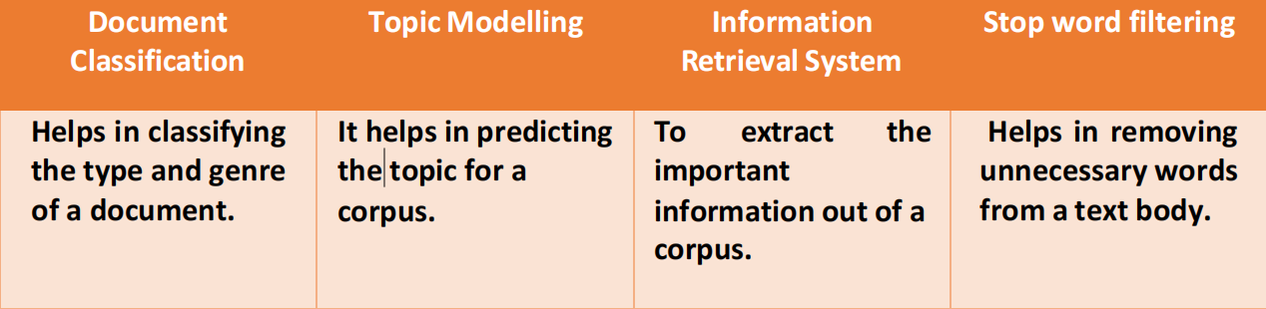
Applications of TF-IDF
TFIDF is commonly used in the Natural Language Processing domain. Some of itsapplications are:

Slide 34
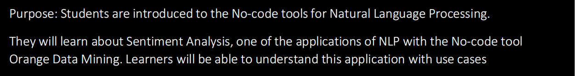
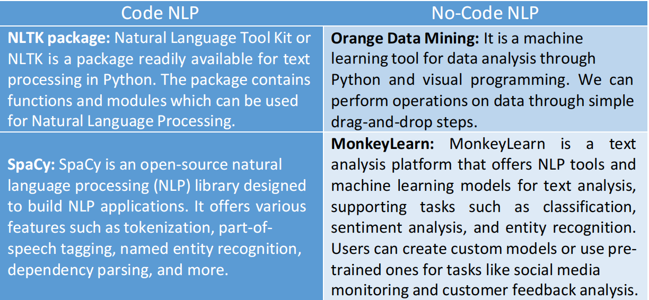
NLP - Case Walkthrough
Examples of Code and No-code NLP Tools

Slide 35


